Slide 1

Importance of Flood Monitoring and Early Warning Systems
Discover why having an effective flood monitoring and early warning system is crucial in preventing disasters, minimizing damages, and saving lives.

Slide 2
Components of a Flood Monitoring and Early Warning Program
Data Collection
Real-Time Monitoring
Explore the different methods and technologies used to collect accurate and real-time data for flood monitoring.
Learn how advanced sensors and satellite imagery enable continuous monitoring of flood-prone areas.
Analysis and Prediction
Communication and Collaboration
Discover how data analytics and modeling are utilized to predict flood events and assess potential risks.
Understand the importance of effective communication channels and collaboration among stakeholders.

Slide 3
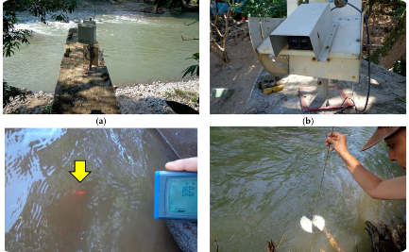
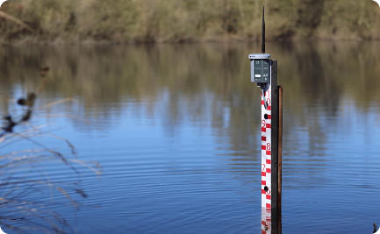
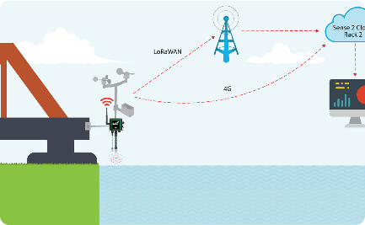
Data Collection and Real-Time Monitoring
Remote Sensing
In-Situ Sensors
Internet of Things (IoT)
See how satellite imagery and aerial photography provide valuable data for flood monitoring.
Learn about river level sensors and weather stations used to collect real-time data on rainfall and water levels.
Explore how connected devices and smart technologies enhance real-time monitoring and data transmission.

Slide 4

Early Warning System and Alert Dissemination
1
Risk Assessment
Evaluate flood risks in real-time and notify authorities and public accordingly.
2
Warning Generation
Utilize predictive models and algorithms to generate accurate and timely flood warnings.
3
Alert Dissemination
Witness the efficient dissemination of alerts through various channels like SMS, mobile apps, and sirens.

Slide 5
Case Studies of Successful Flood Monitoring Programs
Netherlands
Japan
United States
Learn from the world-renowned Dutch flood monitoring system that has safeguarded the nation against flooding for centuries.
Delve into Japan's innovative flood control measures and early warning systems, developed to prepare for typhoons and heavy rainfall.
Discover how the U.S. utilizes advanced technologies and comprehensive flood monitoring strategies to protect vulnerable areas.

Slide 6

Conclusion and Call to Action
Reflect on the importance of investing in robust flood monitoring programs and join the global effort to mitigate the devastating effects of floods worldwide.

